Slide 1
2020 Doodad Shoe sculpture contest
Congratulations Winners!!!

Slide 2
K-2nd Participants

Slide 3
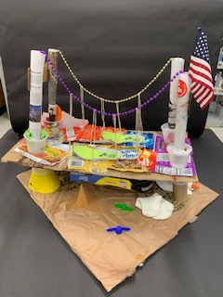
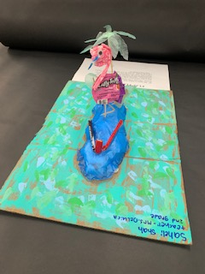
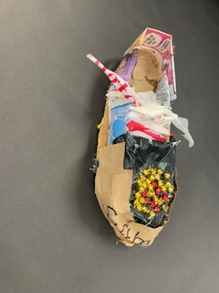
Ethan Goldberg KG-Ordonez
Hannah Gralke and Reese Guida
2nd -DeLucia
Saheli Shah
2nd -DeLucia

Slide 4
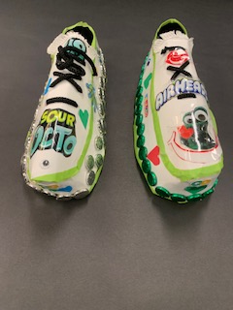
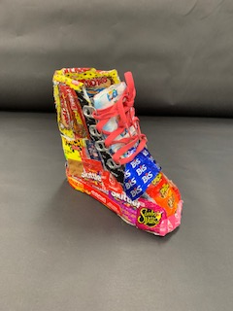
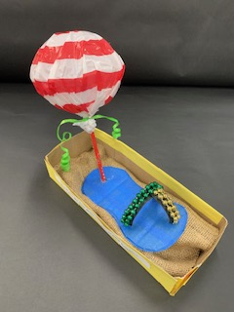
Dina Boukantar 2nd-DeLucia
Max Boex
1st -Wolfe
Olivia Rivas-Medeiros
1st -Delcastillo

Slide 5
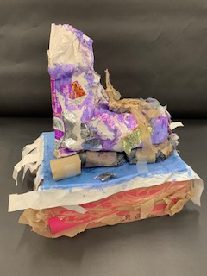
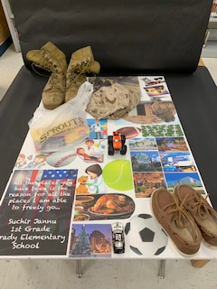
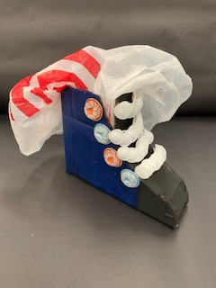
Aaliyah Noor 2nd-Price
Suchir Jannu
1st -Delcastillo
Pablo Gomez
2nd -Price

Slide 6
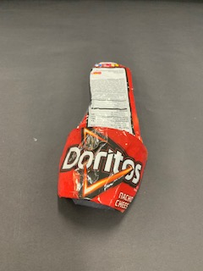
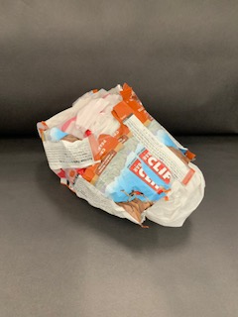
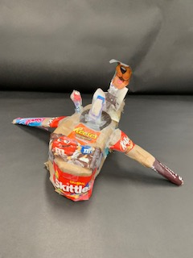
Rayla Beltran 2nd-DeLucia
Ellis DeMuro
KG -Finitz
Mackenzie Currea
1st -Wolfe

Slide 7
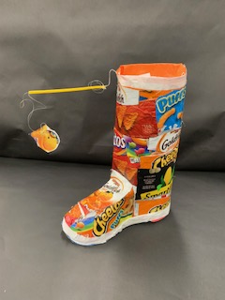
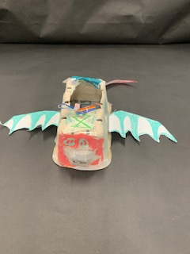
Gustavo Rivas-Medeiros 1st-Delcastillo
Declan O’Donnell 2nd-Buell

Slide 8
3rd-5th Participants

Slide 9
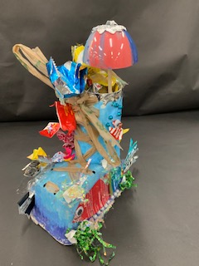
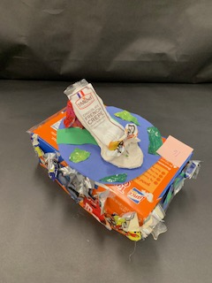
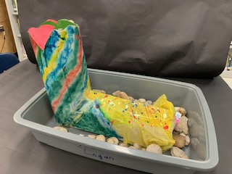
Luci Dingle and Anabella O’Donnell 4th-Dickens
Alexis Logan
4th -Ritter
Gabby Menzer
3rd-Doremus

Slide 10
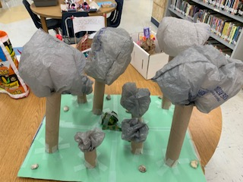
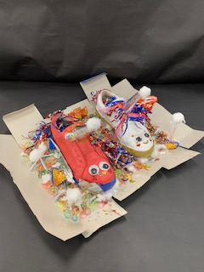
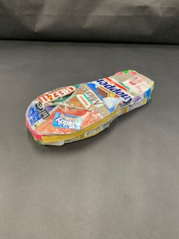
Jayleen Rosa 4th-Reyher
Talia Logan
3rd-Newberry
Yasir Cheban and Mason Kerstettar
3rd -Neldner

Slide 11
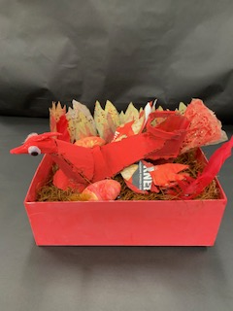
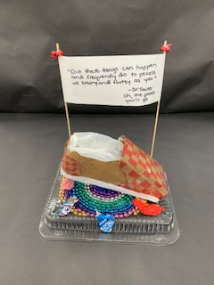
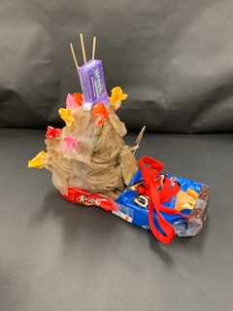
Isabella Vertaille and Alessandra Vertailler 3rd-Oliva 5th-Steel
Isabella Boex
3rd-Newberry
Matias Currea
3rd-Neldner

Slide 12
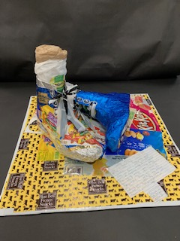
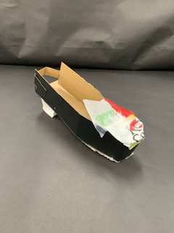
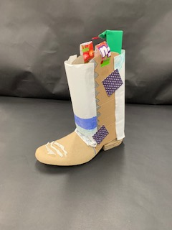
Amina Devoe 5th-Steel
Mason Dotson
3rd-Newberry
Marissa Dotson
4th-Ritter

Slide 13
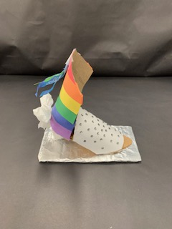
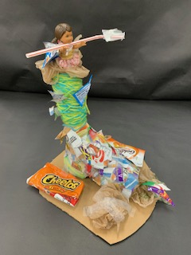
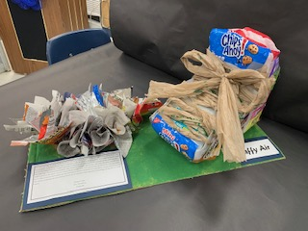
Kaila Ledford 5th-Trupp
Milania Capo
3rd-Newberry
Aspasia Panos
3rd-Doremus

Slide 14
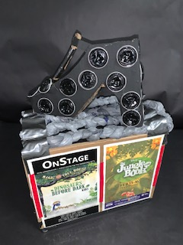
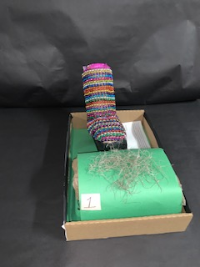
Ana Gomez 4th-Ritter
Charlotte Boex
3rd-Newberry

Slide 15
K-2nd Winners

Slide 16
Ethan Goldberg KG-Ordonez
“HONORABLE MENTION”
Olivia Rivas-Medeiros
1st -Delcastillo

Slide 17
“3RD PLACE”
Mackenzie Currea
1st -Wolfe

Slide 18
“2ND PLACE”
Saheli Shah
2nd -DeLucia

Slide 19
Gustavo Rivas-Medeiros 1st-Delcastillo
“1ST PLACE”

Slide 20
3rd-5th Winners

Slide 21
Ana Gomez 4th-Ritter
“HONORABLE MENTION”
Luci Dingle and Anabella O’Donnell 4th-Dickens

Slide 22
Isabella Vertaille and Alessandra Vertailler 3rd-Oliva 5th-Steel
“3RD PLACE”

Slide 23
“2ND PLACE”
Milania Capo
3rd-Newberry

Slide 24
“1ST PLACE”
Amina Devoe 5th-Steel

